Slide 1
Team 10 – [S.A.Y] [Liu Bowen Mao Yifan Zhang Chuanxin Huang Qianzhi]

Slide 2
Intelligent Pot
1. Collect the images of cooking
2. Identify the process of cooking, and show it by LCD
3. When the dish is ready and fire is not turned off , buzzer will sound
4. Record the ingredient to Database

Slide 3
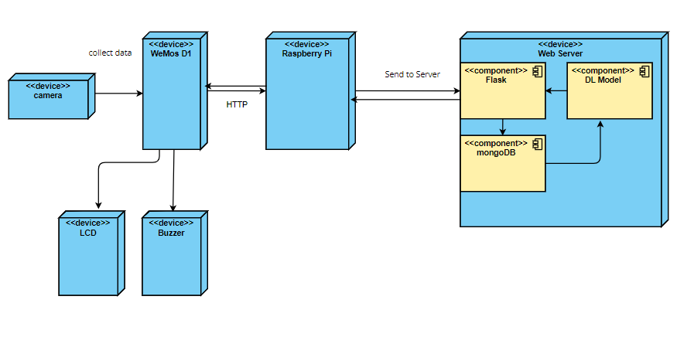
Deployment Diagram

Slide 4
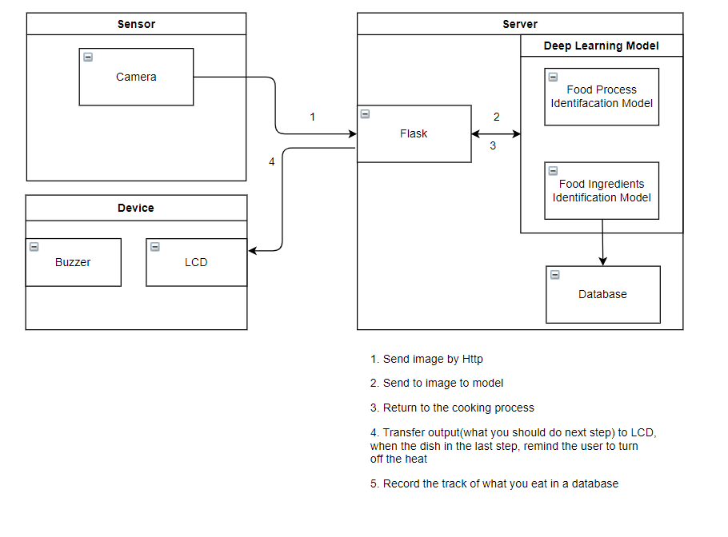
Intelligent Pot: Overview

Slide 5
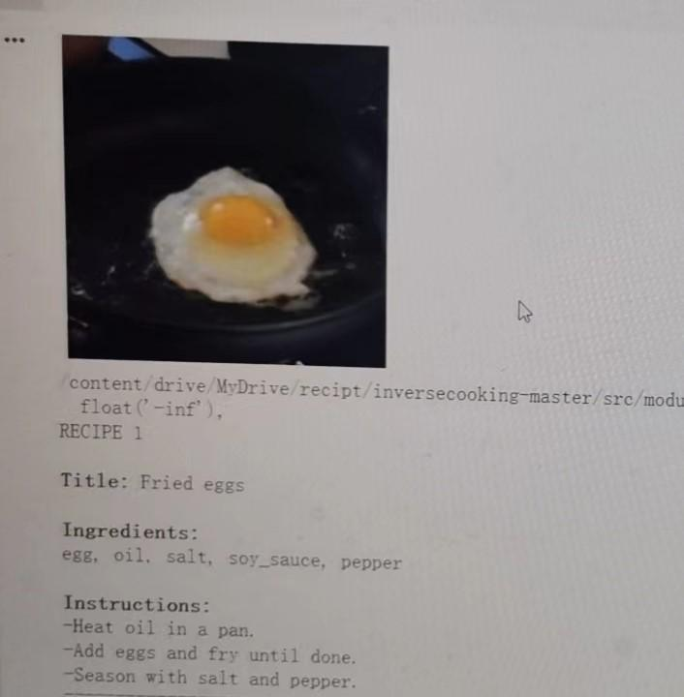
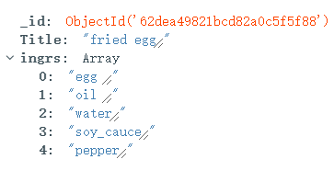
Intelligent Pot:Record the ingredient to Database
We can analyze the ingredients from the image of the dish by Recipe generation model[1]
And we will record the ingredients in the database
(the content we record in database)

Slide 6
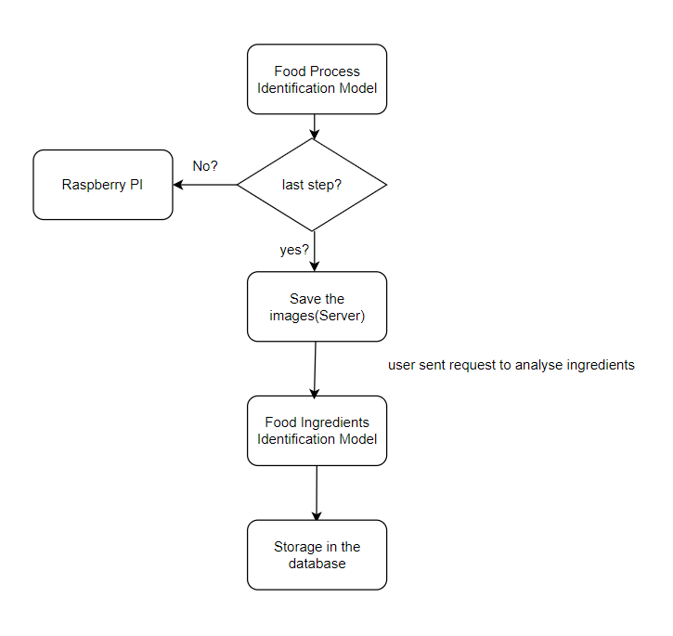
Intelligent Pot:Record the ingredient to Database
Food Ingredients Identification Model is used when users need
(Food Ingredients Identification Model workflow chart)

Slide 7
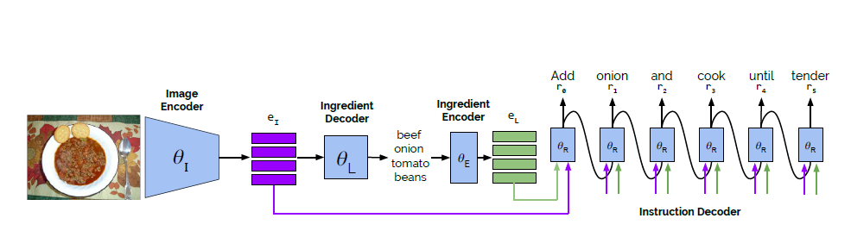
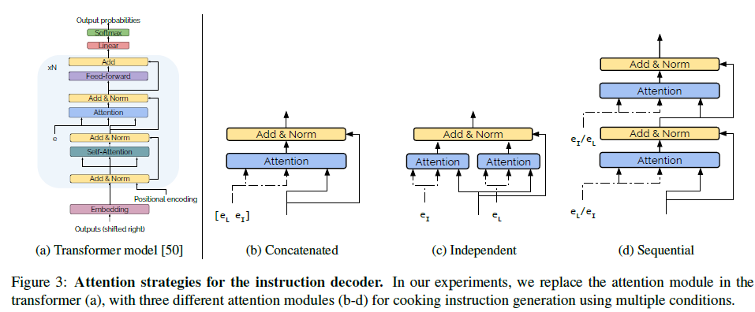
Intelligent Pot:Record the ingredient to Database

Slide 8
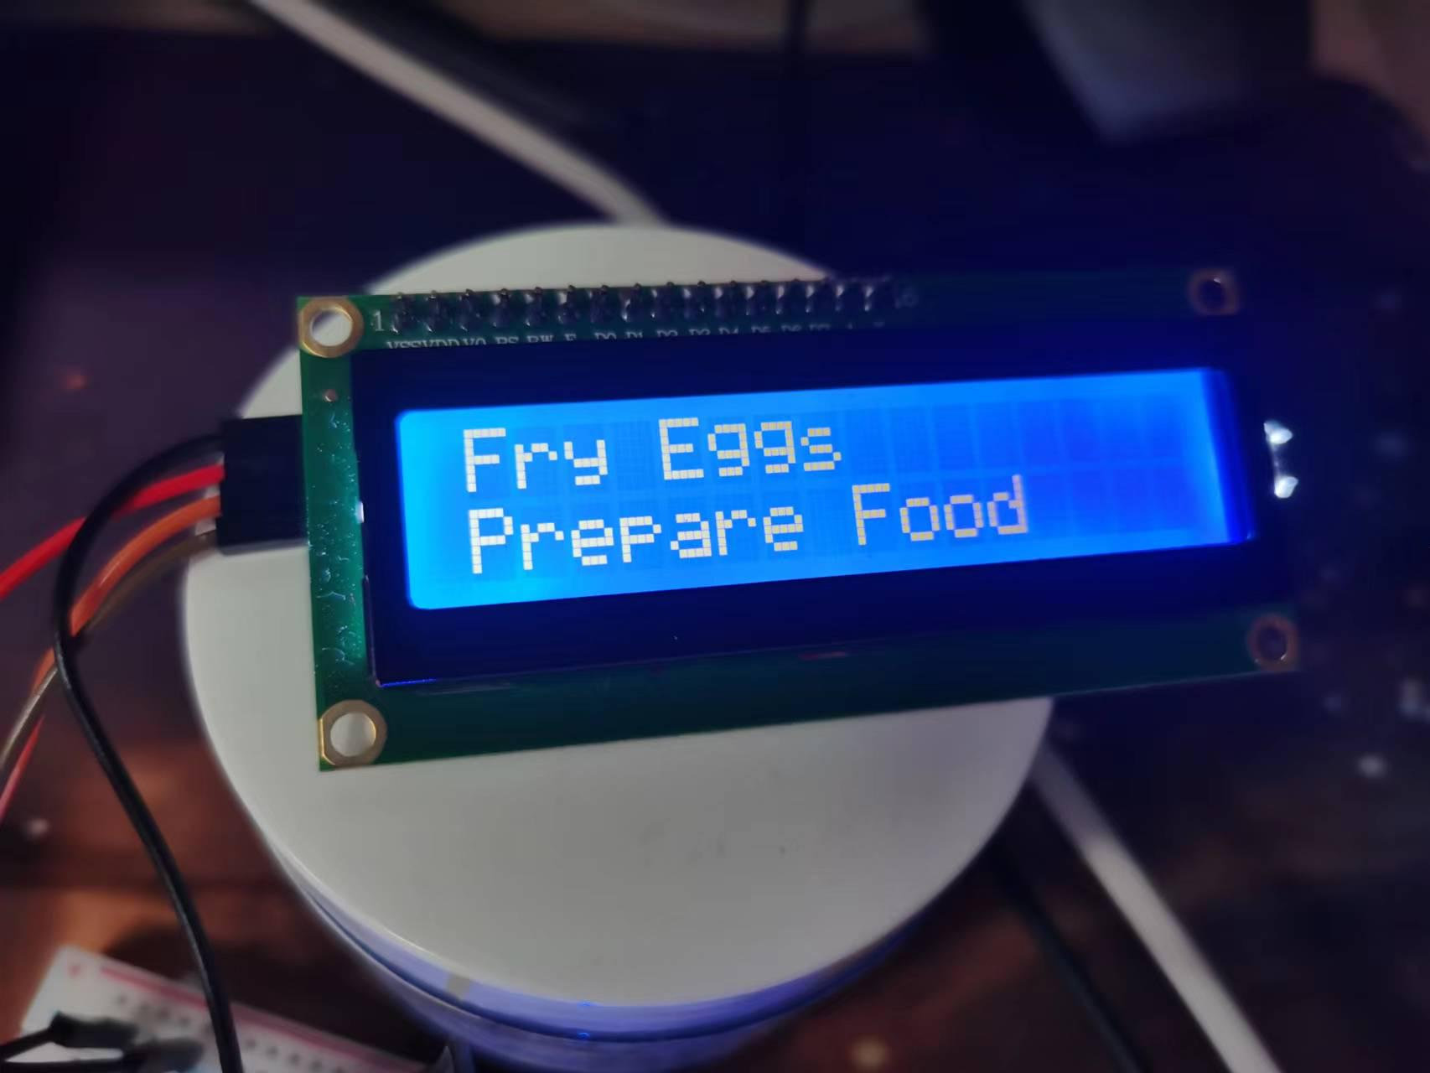
Intelligent Pot: Identify the process of cooking
We can remind the user what he should do in the next step by cooking images
And we use the ShuffleNet v2 to decrease the effect of model compution delay

Slide 9
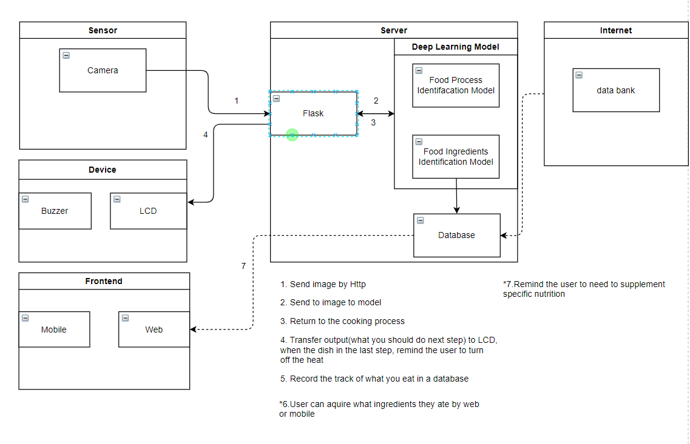
Intelligent Pot: Potential

Slide 10
Conclusion
We collect images of the cooking process and rename them by category to facilitate the subsequent training process.
Our DL model is shufflenet v2 which is a lightweight CNN network.
The inputs of model is the images that have already been processed.
The result of DL model is related cooking information and reminder messages.

Slide 11
Reference
[1]. Salvador, A., Drozdzal, M., Giró-i-Nieto, X., & Romero, A. (2019). Inverse cooking: Recipe generation from food images. In Proceedings of the IEEE/CVF Conference on Computer Vision and Pattern Recognition (pp. 10453-10462).

